Slide 1
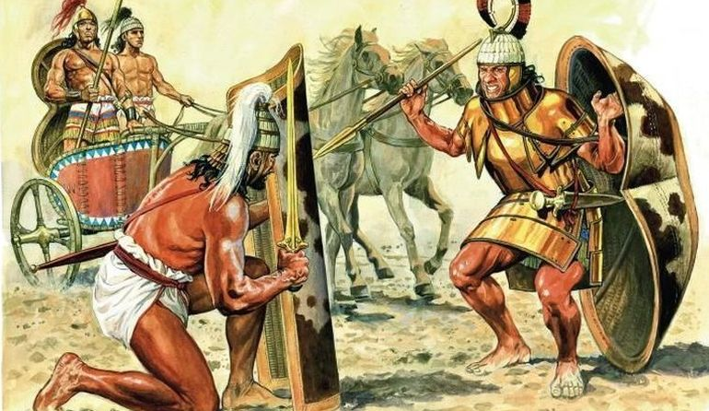
The Myceneans
Goal/s:
describe the Mycenean religious structures
Week 8 Lesson 2
Ms Barrie

Slide 2
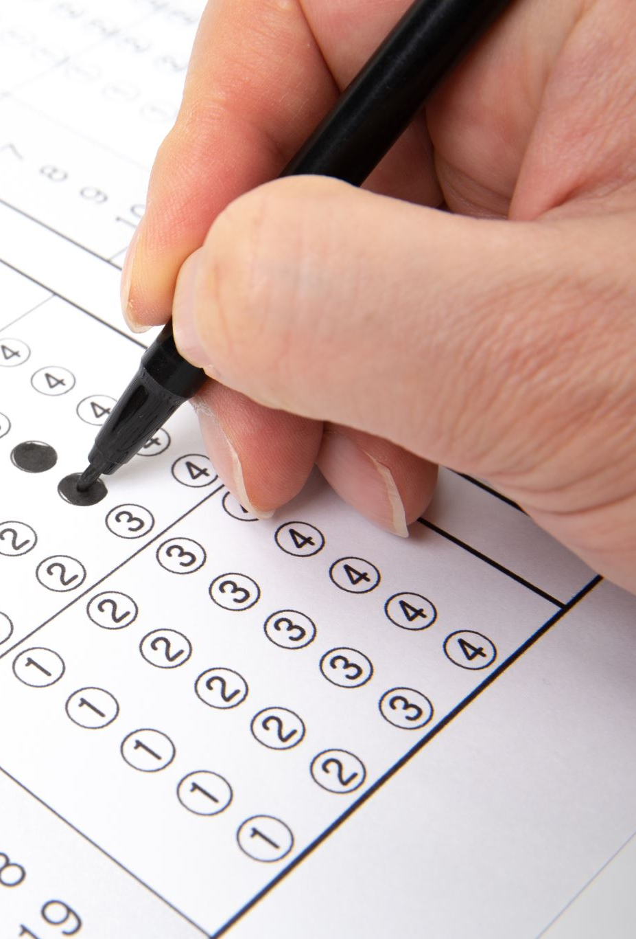
ACTIVITY 1 – Mini whiteboards quiz
Get ONE (1) mini whiteboard, marker, and wipe between two
Answer on the whiteboard the CORRECT LETTER in the multichoice quiz
HOVER IT
CHIN IT
PARK IT

Slide 3
Question 1
Who were the Basileis?
The Slaves
The Nobility
The King’s Advisers
The King
Notes:
ANSWER – B Nobility

Slide 4
Question 2
Who were the lawagetas?
The Nobles
The King’s Advisers
The Slaves
The War Leader
Notes:
ANSWER – D War leader

Slide 5
Question 3
Slaves were known as…
Hequetai
Temenos
Damos
Lawiaia
Notes:
ANSWER – D

Slide 6
Question 4
What had to be IMPORTED into Mycenae?
Animal Hides
Corn Crops
Raw Materials
Pottery
Notes:
ANSWER – C Raw Materials

Slide 7
Question 5
Which of these is FALSE?
The citadels were based inland
The Mycenaeans invented corbelling
They traded with Asia Minor and Syria
The King was seen as ‘divine’
Notes:
ANSWER – B Corbelling wasn’t invented by them, but used

Slide 8
Today’s Lesson
Religion, death and burial
Culture

Slide 9
Religion
Heavily influenced by Minoans
Cult participation – MEGARON as main room of palace for religious practices
Gods, Goddesses, and Heroes

Slide 10
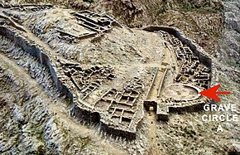
Funerary Customs and Rituals
Grave sites with precious materials
Tholoi (tombs) chambers were cut into sides of hills with a passageway called a dromos
Dead were usually buried
Offerings were burnt – reason unknown
Belief – flesh decayed and spirit released
A lot still unknown

Slide 11
ACTIVITY – Compare and Contrast
Create an A4 poster Comparing (similarities) and Contrasting (differences) between the Minoans and Myceneans
You might do this in a table or Venn diagram
You need to think about their social, economic, political, religious, and cultural structures – as well as their key dates, people, and location.

